Slide 1
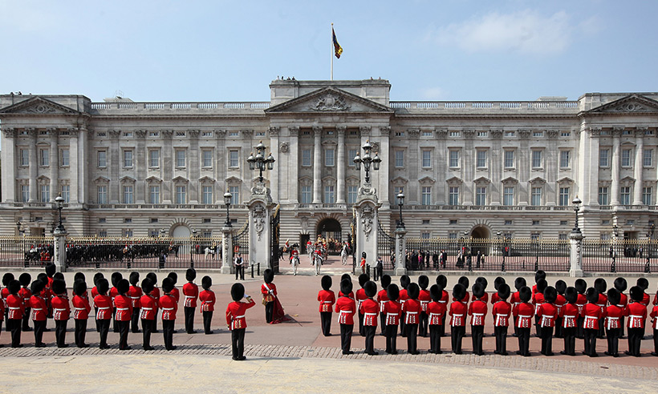
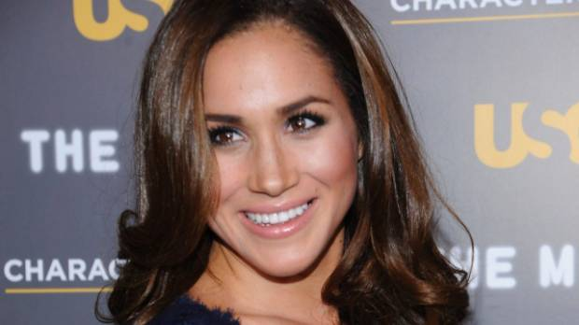
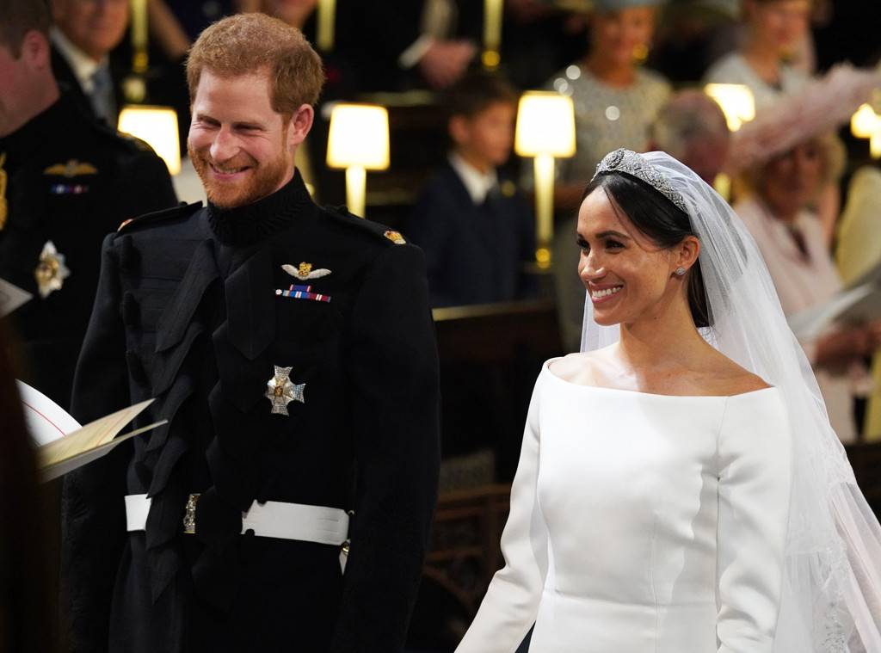
Buckingham Palace白金漢宮
Prince Harry & Princess Meghan

Slide 2
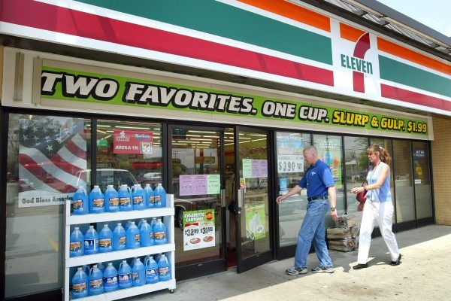
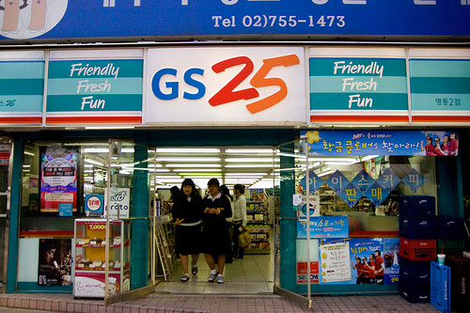
post office
convenience store

Slide 3
post office
department store

Slide 4
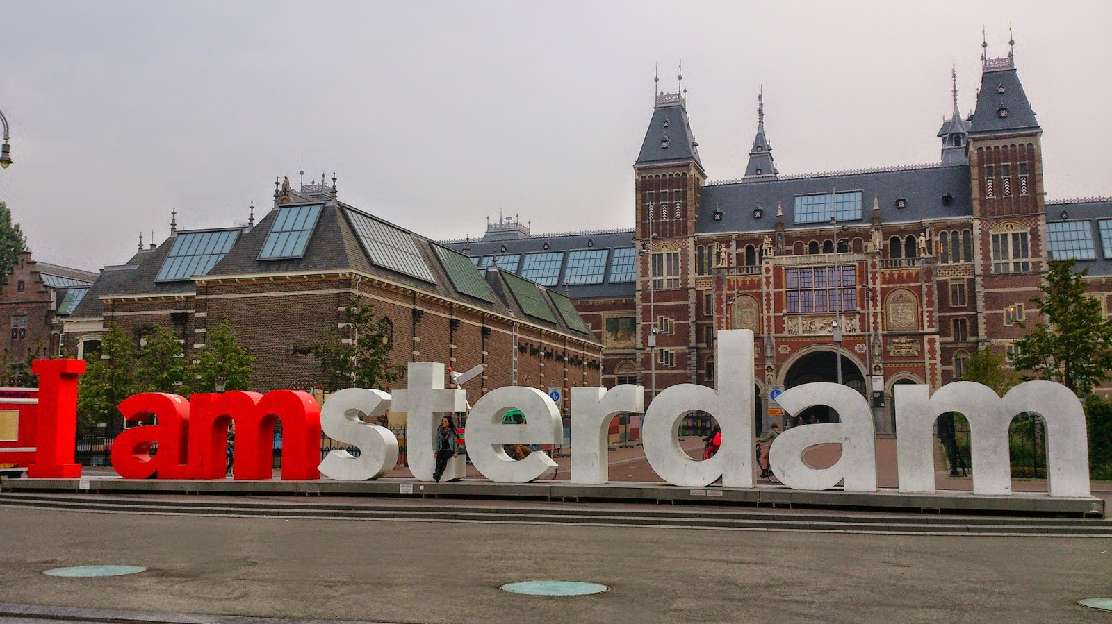
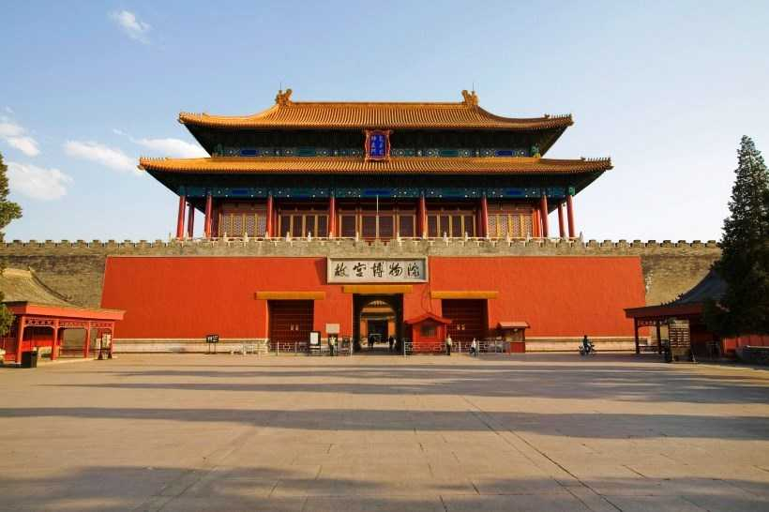
museum

Slide 5
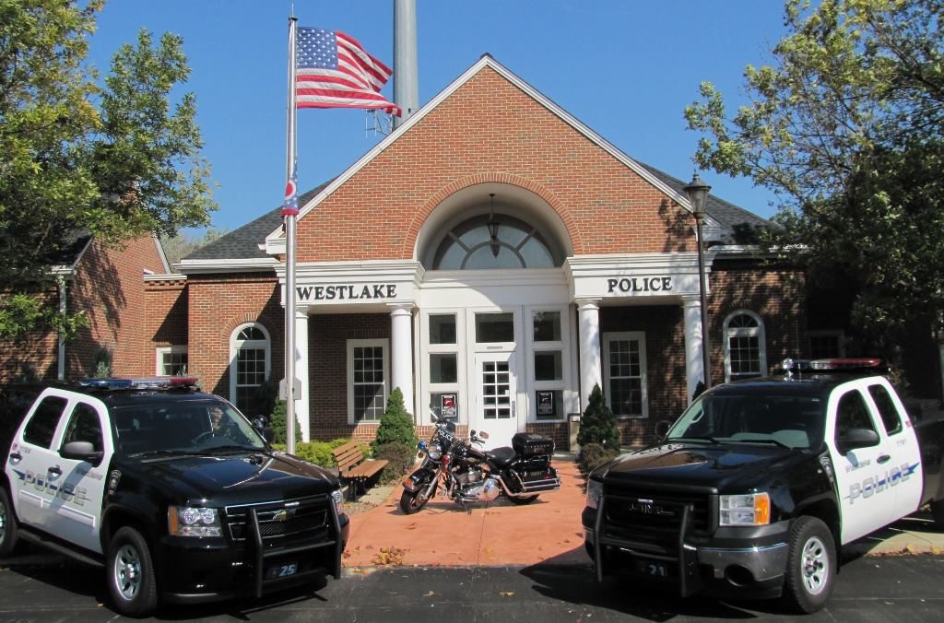
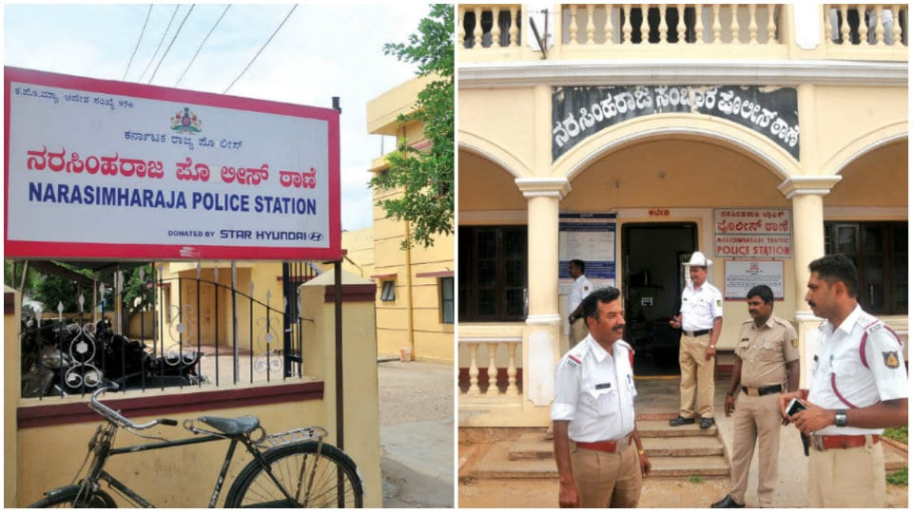
post office
police station

Slide 6
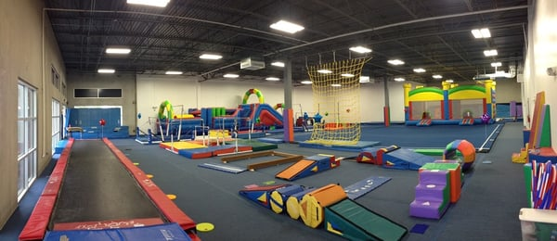
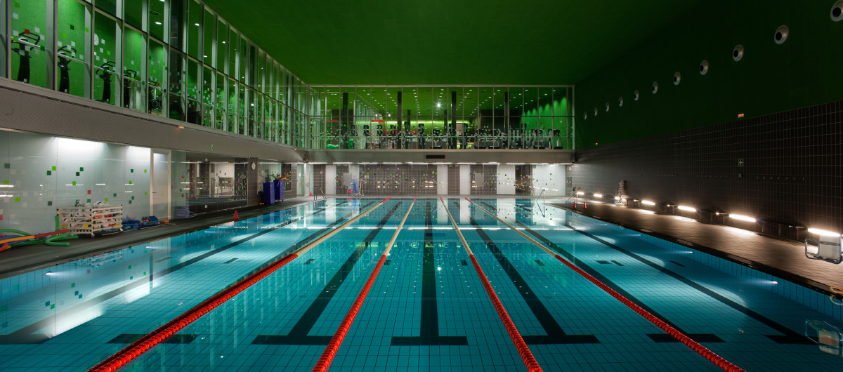
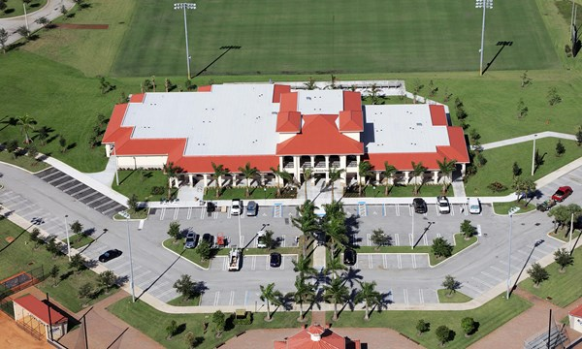
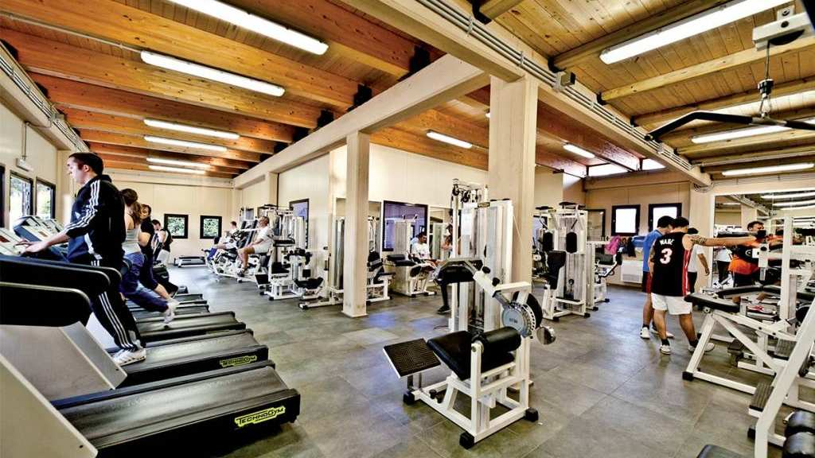
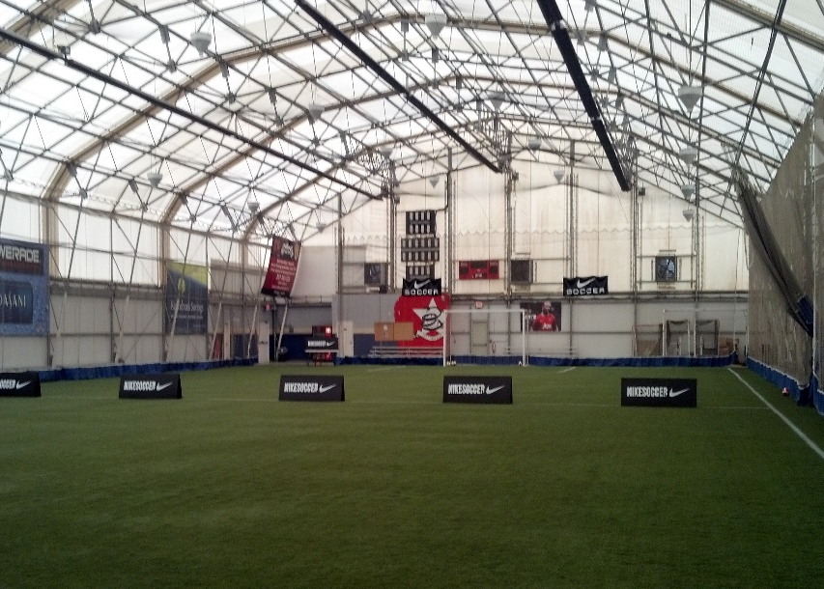
post office
sports center

Slide 7
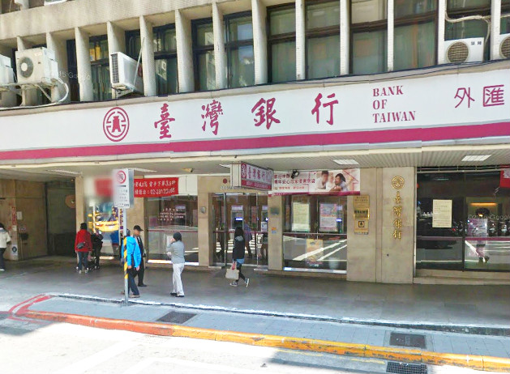
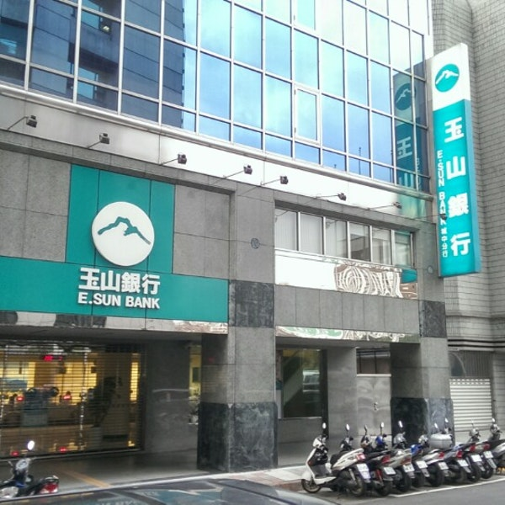
res∙tau∙rant
bank

Slide 8
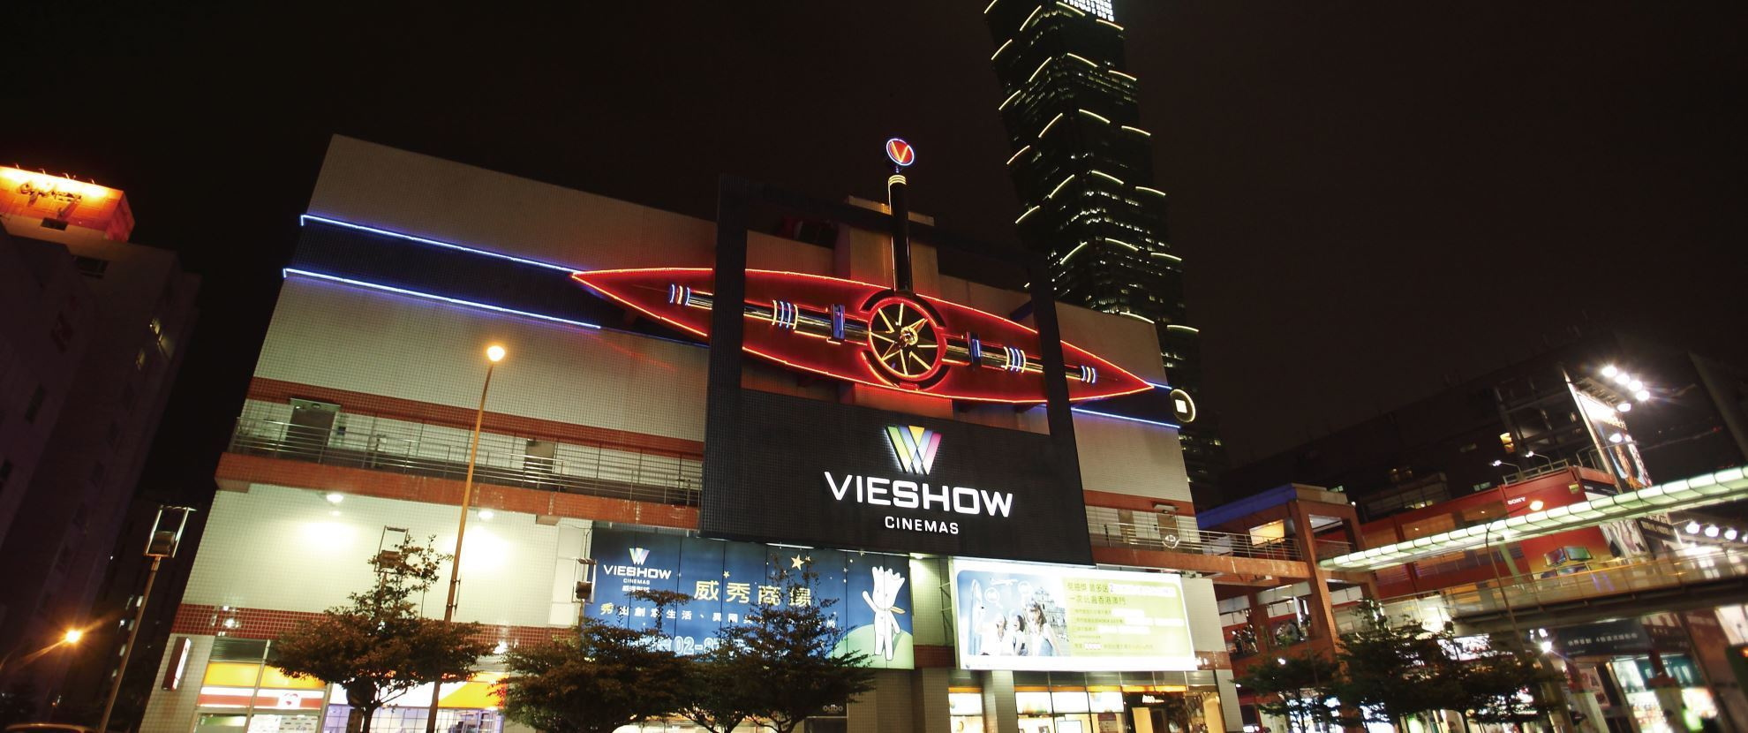
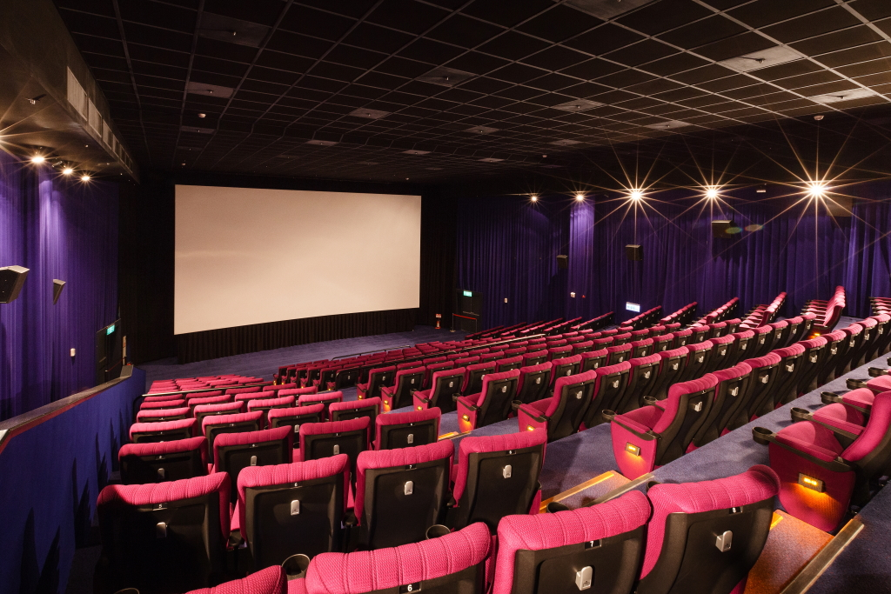
res∙tau∙rant
movie theater

Slide 9
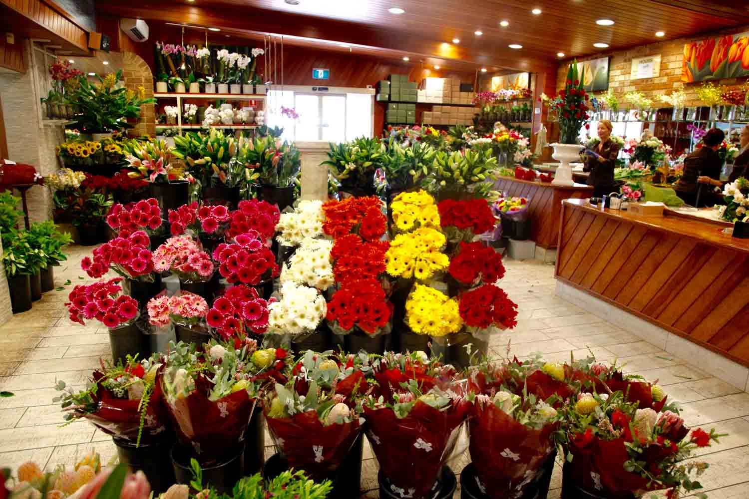
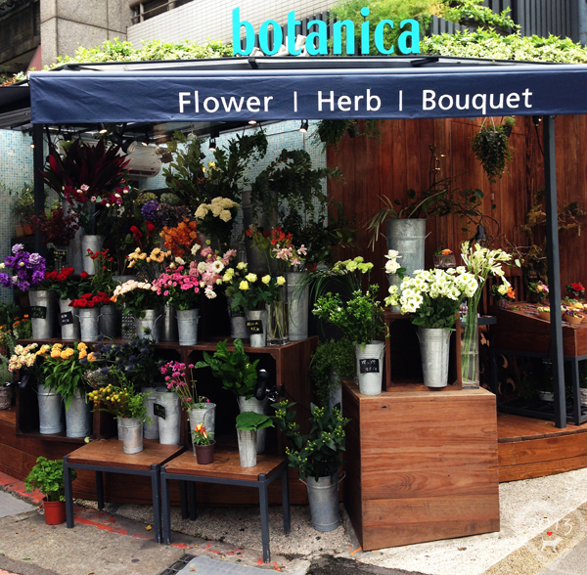
res∙tau∙rant
florist

Slide 10
hos∙pi∙tal
hospital

Slide 11
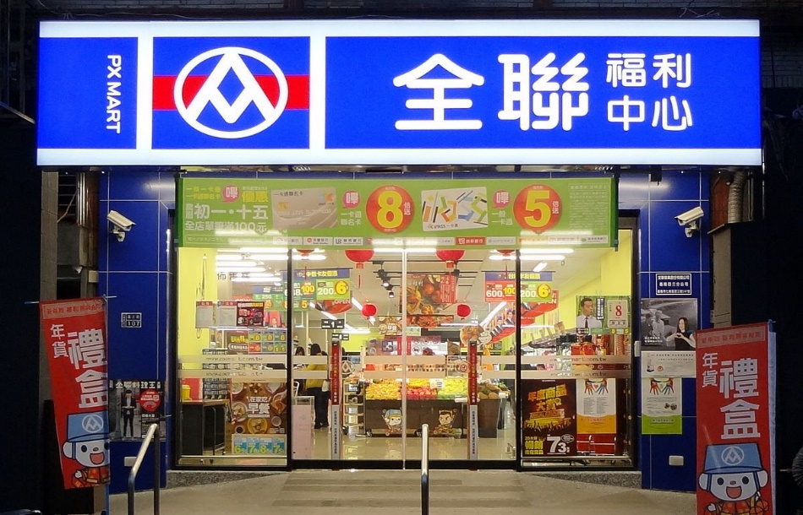
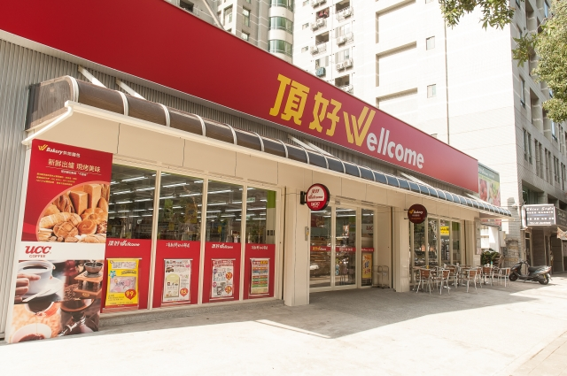
su∙per∙mar∙ket
supermarket

Slide 12
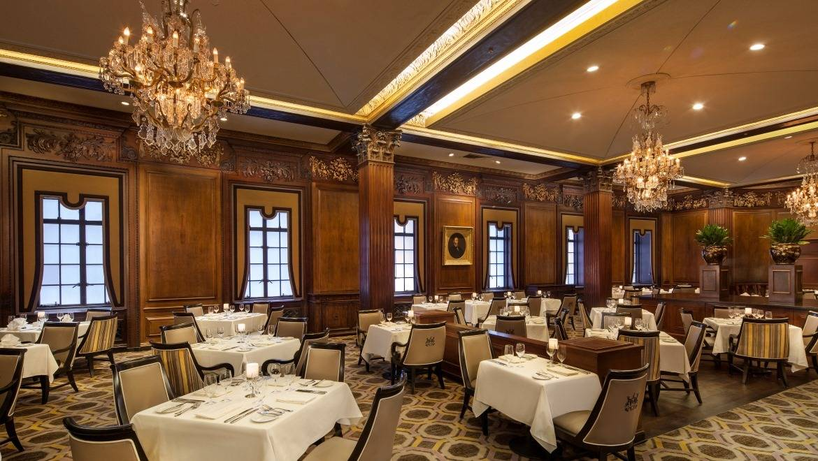
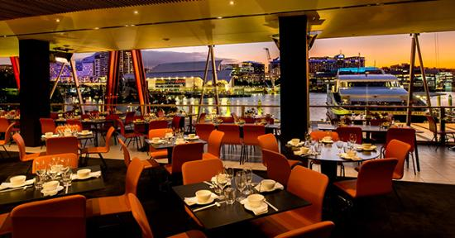
res∙tau∙rant
restaurant

Slide 13
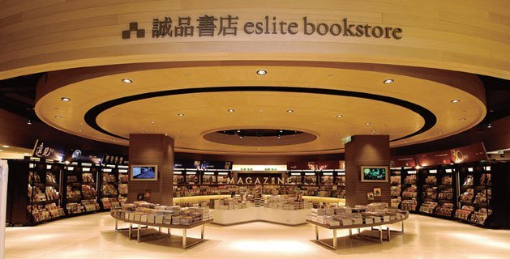
book∙store
bookstore

Slide 14
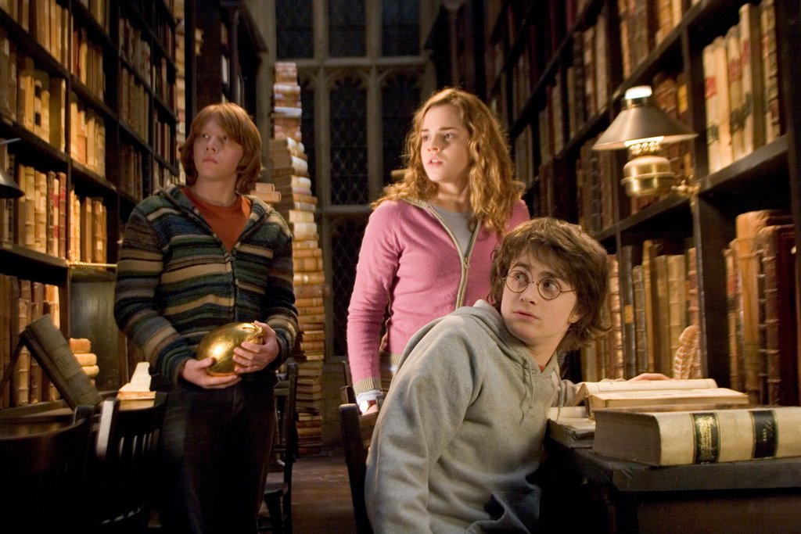
li ∙ bra ∙ ry
library

Slide 15
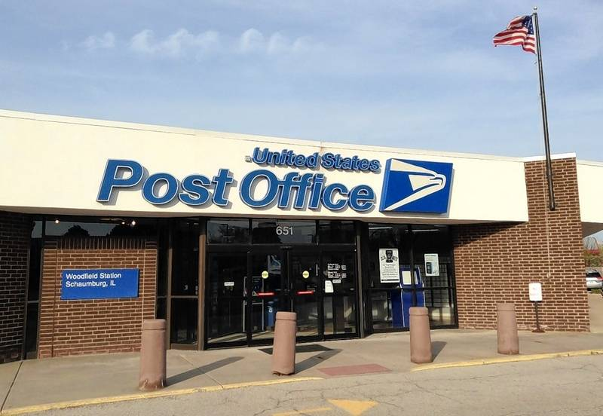
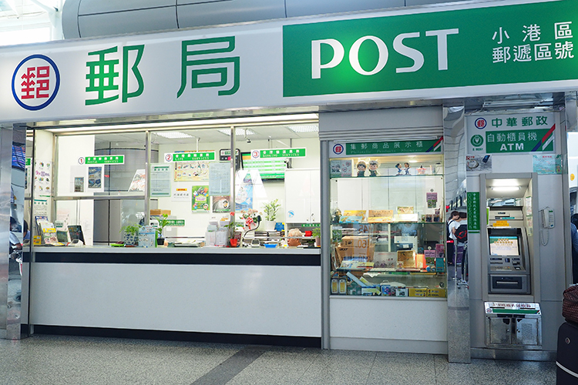
post office
post office

Slide 16
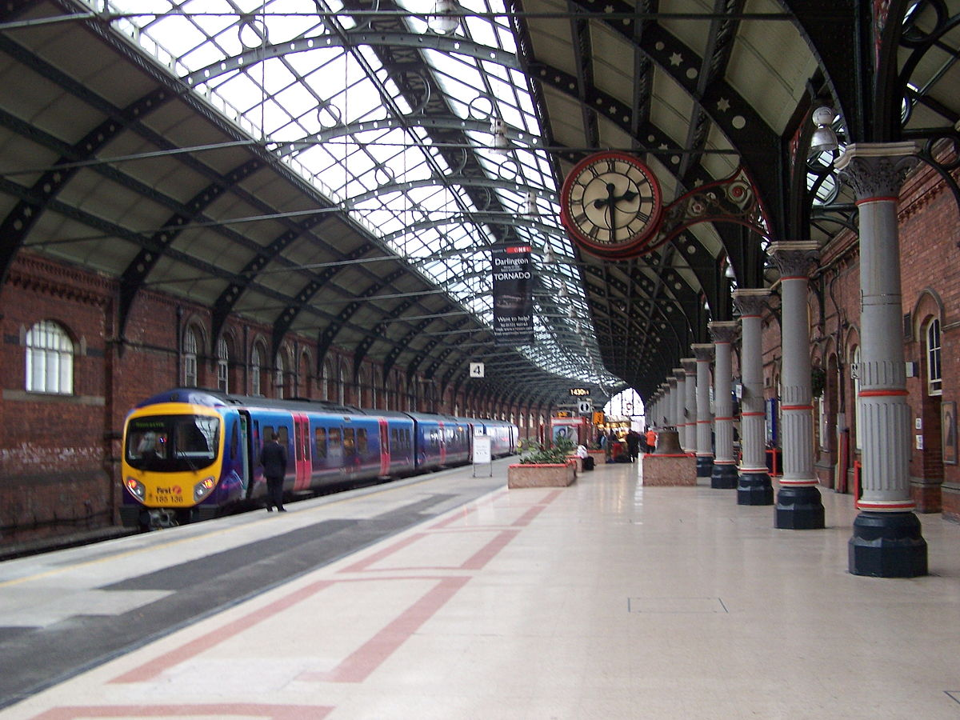
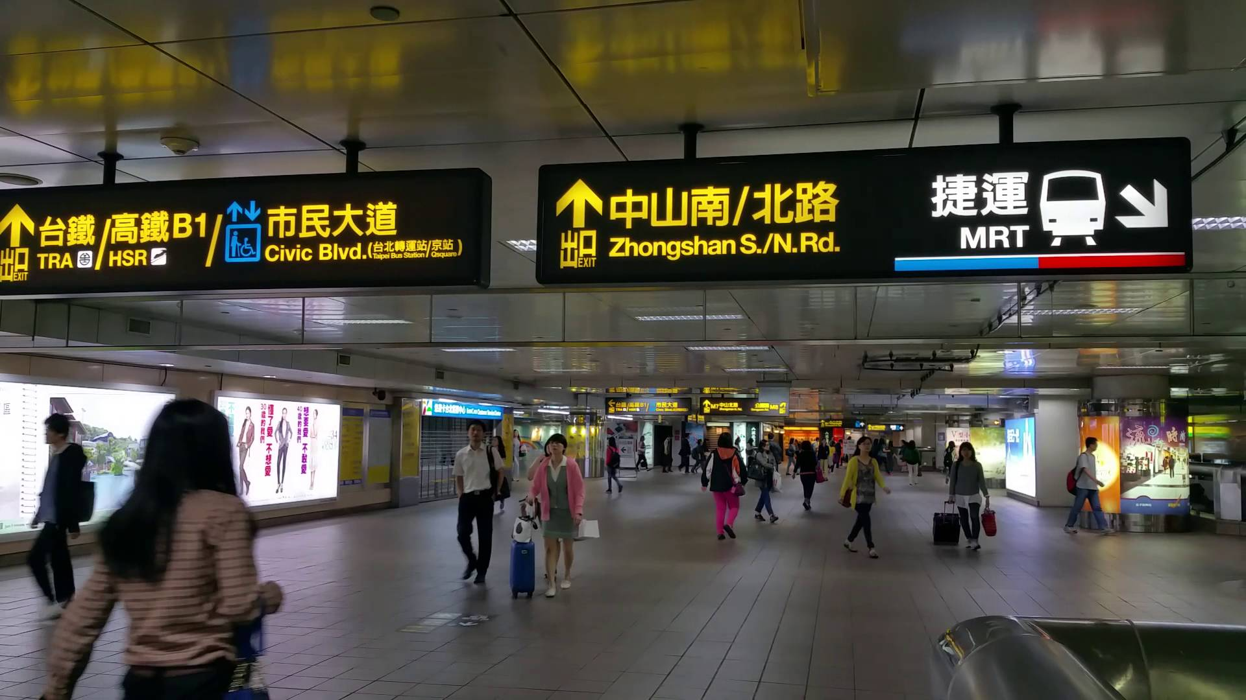
train station
train station

Slide 17
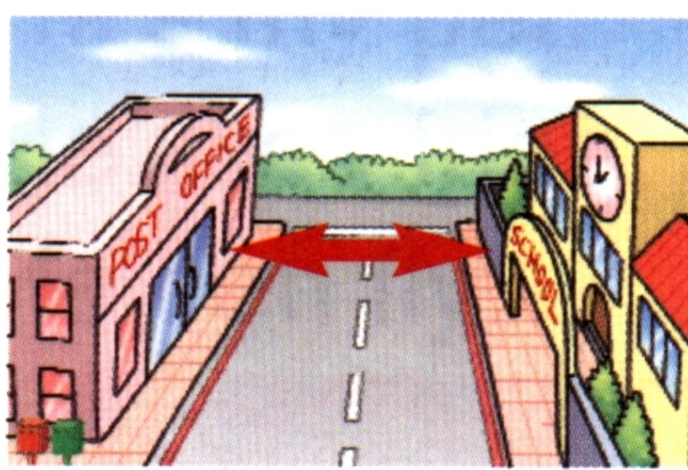
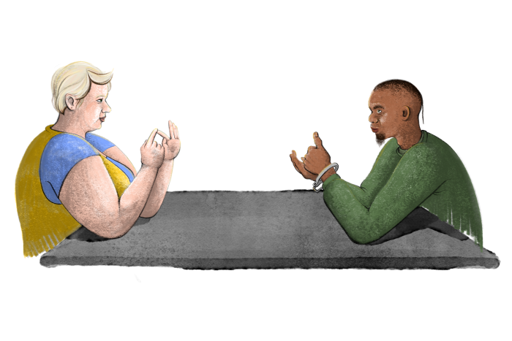
across from

Slide 18
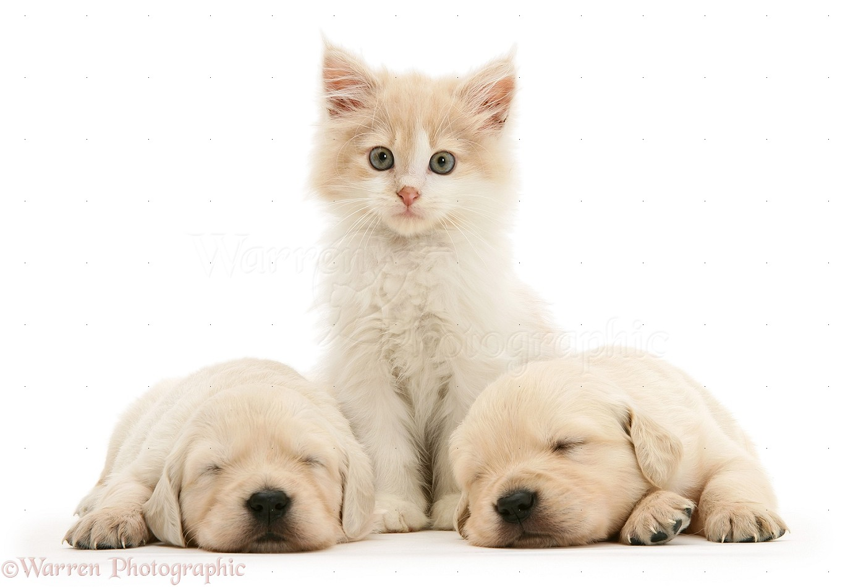
between

Slide 19
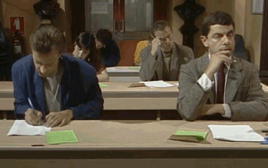
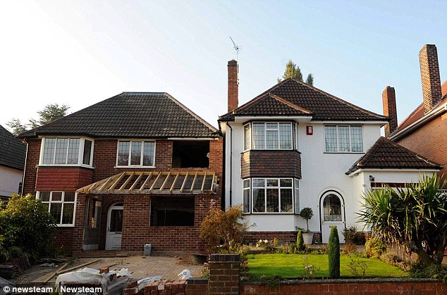
next to

Slide 20
department store
park
police station
MRT
station
sports center
school

Slide 21
Where is the police station?
Xinyi police District, Taipei City Police Department
It’s across from the sports center.
It’s across from Taipei Xinyi Sports Center.

Slide 22
department store
park
police station
MRT
station
sports center
school

Slide 23
Where is the MRT station?
Taipei 101 / World Trade Center
It’s next to the department store.
It (Exit 5) is next to Taipei 101.

Slide 24
department store
park
police station
MRT
station
sports center
school

Slide 25
Is Xinyi Elementary School across from the MRT station?
Yes, it is. It’s across from Taipei 101 / World Trade Center Station Exit 3.

Slide 26
department store
park
police station
MRT
station
sports center
school

Slide 27
Is the park (Xinyi Plaza) between the sports center and the school?
No, it isn’t. It’s between the police station and the department store.

Slide 29
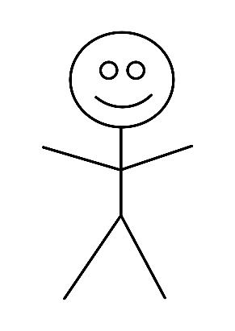
movie theater
bank
florist

Slide 30
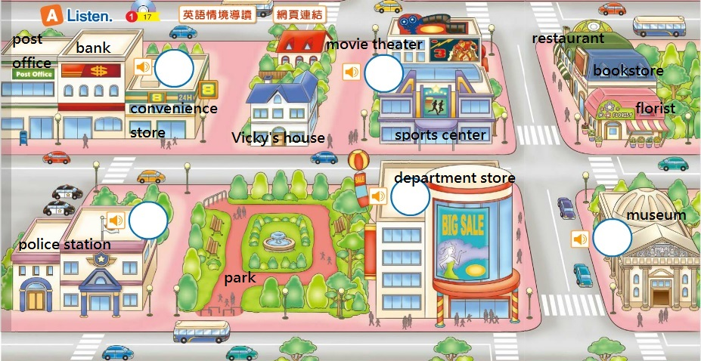

Slide 31
【本週英語作業】
聽:CD 1第21~23首。
訂簽:習作Unit1，錯的練習5遍。
寫: 習作P28~P29
考: Unit 2單字/句型
※玩Quizlet第二課文法篇

Slide 32
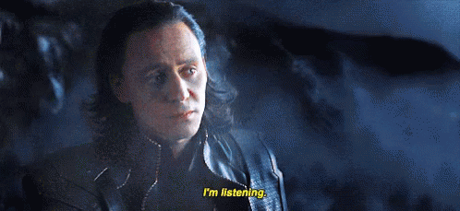

Slide 33
True or False?
1. The museum is across from the police station.

Slide 34
True or False?
2. The girls love to watch baseball games so much.

Slide 35
3. Where are the girls?

Slide 36
4. Where are they going to go next weekend?

Slide 37
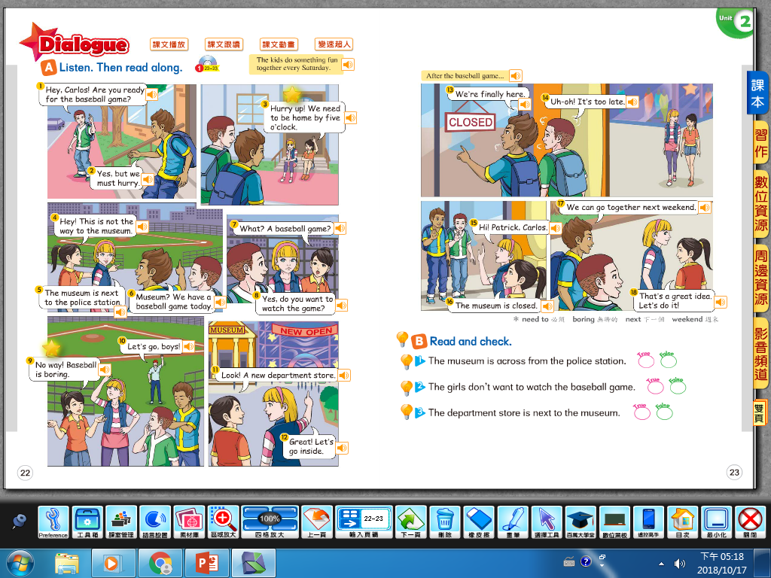

Slide 38
Copy the intonation of CD!

Slide 39
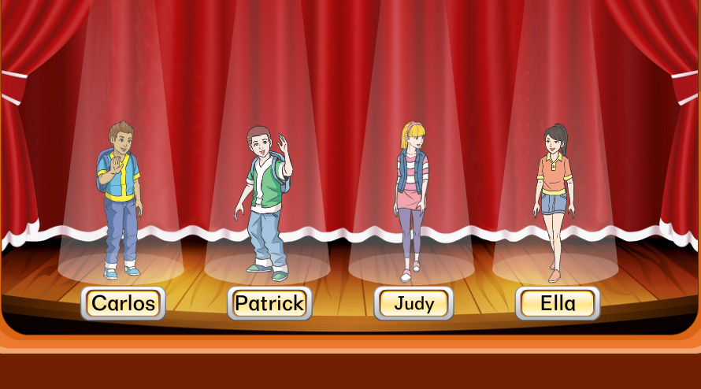
Role Play

